Slide 1
SPRING 2018 FULL FACULTY MEETING

Slide 3
Business
Minutes Fall Full Faculty meeting
10-25-17
Minutes of AS Council available on website for your review of A.S. activities
Agenda
Year end report of Academic Senate
Committee reports
Results of Election 2018
Results of Faculty Survey
Guest Speaker

Slide 4
Year-End Report: Activities
Initiatives
Communication with Human Resources regarding benefit changes
Chancellor’s Search
OSPAN advisory committee
Logo created
Suggestions for GUS from faculty perspective
Worked with administration with evolving policy for reduction in faculty salaries due to performance
Ad Hoc Committee appointed to help develop policy, Dr. Howard Hendrickson, Chair
Representatives included department chairs & faculty
5 points identified across colleges/clinicians (see 9-27-17 meeting minutes)
Suggest that these are good starting point for upcoming changes.
Communication from faculty members shared with Provost
Sponsored a needy family at Christmas
Notes:
Recommendation to encourage HR to communicate with Academic Senate to draft new policies
More appointment days for meetings with faculty instituted

Slide 5
Year-End Report: Activities
Appointment, Promotion, Tenure, Non-Reappointment, and Dismissal of Faculty Policy Revisions 405.1, 405.4
Communication with faculty: Website, blogs, newspapers
Letters to Board of Trustees & Dr. Bobbitt requesting representation
Analyzed changes/communicated recommendations from faculty
Sponsored 2 Faculty Town Halls
Petition drafted: signed by ~700 faculty voicing opposition to 405.1 draft & sent
Attendance at 2 Board of Trustee meetings & UA System counsel
A.S. did not fully support the revisions, asked for a delay of vote for further revisions
Positive Outcomes/many successes because of A.S. participation:
Insisted on being at the table: Communication with faculty at must!
Terms defined (unsat performance)
Remediation plan timeline extension (“meaningful progress” added)
Academic freedom terms redefined
Collegiality “clause” changed
**Annual Performance Evaluation at UAMS: Policy still needed, peer review to be added
Notes:
405.1 Appointment, Promotion, Tenure, Non-Reappointment, and Dismissal of Faculty; Board Policy 405.4 Employment Periods;

Slide 6
Collaboration, Communication
Academic Senate Council meets monthly
Full Academic Senate meets twice per year
Academic Senate Council meets with UAMS Leadership monthly
All Academic Senate College Representatives meet with College Leadership
Minutes of the Academic Senate are available on our website http://academicsenate.uams.edu/
Academic Senate weekly calendar
New entities added
Senate website linked in Friday email

Slide 7
Council Representatives
Appoint. Method | Position | Name | Term Year | Month
Campus Vote | President | Leanne Lefler | 2017-2018 | March
Campus Vote | President-Elect | Lee Ann MacMillan-Crow | 2017-2018 | March
Campus Vote | Past President | Daniel Voth | 2017-2018 | March
Campus Vote | Secretary | Laura Smith-Olinde | 2017-2019 | March
Campus Vote | Parliamentarian | Danny Bercher | 2015-2018 | March
Campus Vote | Member-at-Large | Steven Post | 2016-2018 | March
Campus Vote | Member-at-Large | Alesia Ferguson | 2017-2019 | March
Campus Vote | Member-at-Large | Howard Hendrickson | 2017-2019 | March
Appointed or Vote within College | Health Professions | Benjamin Willett Tiffany Huitt | 2015-2018 2016-2018 | Sept Sept
Appointed or Vote within College | Graduate School | Gunnar Boysen Andrew James | 2016-2018 2015-2018 | May May
Appointed or Vote within College | Public Health | Saleema Karim Feifei Wei | 2016-2018 2016-2018 | May May
Appointed or Vote within College | Medicine | Regis Renard Thea Rosenbaum | 2016-2018 2017-2019 | Jan Jan
Appointed or Vote within College | Nursing | Ellyn Matthews Teresa Whited | 2016-2018 2015-2018 | May May
Appointed or Vote within College | Pharmacy | Keith McCain Cesar Compadre | 2015-2017 2016-2018 | July July
-Abdallah Hayar manages website ; -Student Representative from GSA: Gregory Berbusse; -OSPAN Representative: Lee Ann MacMillan Crow; -UAMS Administrative Network Representative: Gunner Boysen

Slide 8
2018 Election
Andrew James elected President-Elect; Associate Professor, COM; Dept. of Psychiatry and Neurology
Cindy Kane elected Member-at-Large, Professor, COM, Dept. of Neurobiology and Developmental Sciences,
Grover Miller elected Parliamentarian; Professor, Biochemistry & Bioinformatics
We had 404 faculty members vote

Slide 9
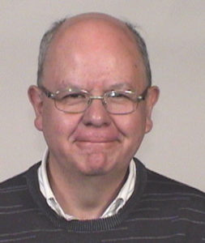
Faculty Affairs Committee
Charges of the committee are:
The general facilitation of faculty at UAMS
Provide a forum for beneficial suggestions, concerns, and complaints in this area and produce recommendations for the Senate to consider
Peprare and conduct the Annual Academic Senate Faculty Survey
The initial areas of interest are:
Policy concerning recruitment and retention of Faculty
Faculty perspective on incentives, promotion, tenure and related policies
Academic excellence (may go to a separate committee in future)
Cesar Compadre; Chair
Members
Phil Breen Mahendran Mahadevan Laura K Smith-Olinde Alesia Ferguson
Maxim Dobrestov
Abdallah Hayar
Howard Hendrickson

Slide 10
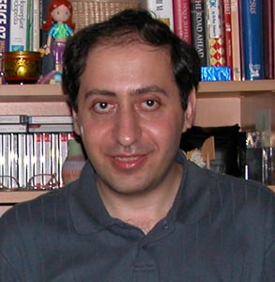
Communications Committee
Chair: Abdallah Hayar (since 8/30/2017); also webmaster (since 2011),
Members: Linda A. Deloney, Mahendran Mahadevan, Maxim Dobretsov
The charges of this committee are: 1. The general support of faculty communication, research communication, and clinical communication at UAMS 2. Provide a forum for beneficial suggestions, concerns, and complaints in this area and produce recommendations for the Senate to consider
-Updating the Academic Senate website with information useful for faculty to communicate with the Academic Senate such as contact information of current officers and representatives.
-Posting announcements regarding faculty town hall meetings.
-Posting the Academic Senate Council minutes and faculty surveys.
-Provide links to other Arkansas Academic Senates and related Associations.

Slide 11
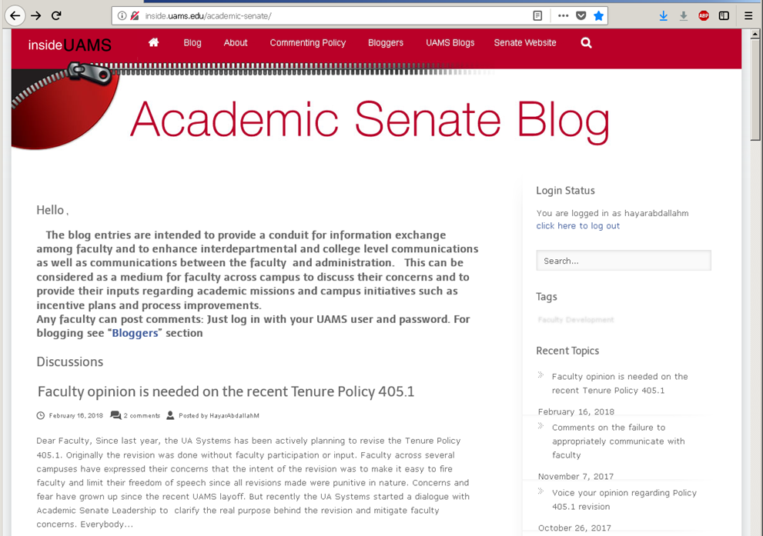
Communications Committee (Recent activities)
http://academicsenate.uams.edu/minutes/
-Kept the faculty informed by posting materials related to Arkansas System Tenure Policy 405.1 revision. >800 visitors since November 22, 2017
Future Plans:
-Generate a monthly or quarterly Academic Senate Newsletter.
-Design strategies to promote faculty communications and participation in institutional governance.

Slide 12
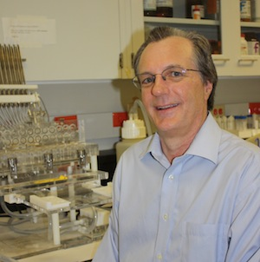
Research Committee
Chair: Paul Prather
Charge: Work within UAMS research mission for communication and exchange of ideas as the basis for a deliberative synthesis & collaboration across campus research entities.
Members:
Borrelli, Michael J
Dobretsov, Maxim
Fuhrman, Barbara J
Hendrickson, Howard P
Heo, Seongkum
Howard, Valerie
Kenchaiah, Satish
Lefler, Leanne
Macmillan-crow,LeeAnn
Rosenbaum, Thea
Steelman, Susan C
Storrie, Brian
Report
-Discussed participation of the Academic Senate as potential “coaches” to help with
assimilation, personal and professional development, career choice, retention, etc., of
Students
-Ideas to improve and enhance research on campus (e.g., establish more
collaborations with the goal of increasing publishing, grant submissions, etc.).
-

Slide 13
UAMS Academic Senate
Faculty Satisfaction and Concerns Survey 2017

Slide 14
OVERALL RESPONSE:
2011: 519
2013: 490
2017: 160
COLLEGE | 2011 | 2013 | 2017
HEALTH-RELATED PROF | 8.5% | 7% | 21% (33)
MEDICINE | 73.5% | 76% | 34% (54)
NURSING | 10% | 8% | 10% (16)
PHARMACY | 6% | 7% | 15% (24)
PUBLIC HEALTH | 2% | 2% | 14% (22)
OTHER (AA) |  |  | 7% (11)
Clear that clinical
faculty had low participation
TRACK | 2011 | 2013 | 2017
NON-TENURE | 33% | 32% | 39%
TENURE-TRACK | 35% | 38% | 26%
TENURED | 27% | 26% | 36%
Shown for ALL faculty.
College breakdown
will be on website…
GENDER | 2011 | 2013 | 2017
FEMALE | 46% | 55% | 55%
MALE | 54% | 45% | 45%
 | 2011 | 2013 | 2017
PART-TIME | 11% | 8% | 6%
FULL-TIME | 89% | 92% | 94%

Slide 15
Education
5= strongly agree
4= agree
3= no opinion
2 = disagree
1 = strongly disagree
To what extent do you agree with the following statements: | 2011 | 2013 | 2017
UAMS encourages educational excellence | 3.11 | 3.24 | 3.44
Excellence in teaching is recognized/rewarded | 3.11 | 3.24 | 3.44/2.94
Education is well supported | 3.16 | 3.02 | 3.15
Education valued = with research / clinical activity | 2.36 | 2.45 | 2.37

Slide 16
Research
5= strongly agree
4= agree
3= no opinion
2 = disagree
1 = strongly disagree
To what extent do you agree with the following statements: | 2011 | 2013 | 2017
UAMS policy and practices encourage excellence on research | 3.55 | 3.47 | 3.45
Bridging mechanisms and policies for research are adequate | 2.86 | 2.81 | 2.60
I have adequate opportunities to collaborate with other faculty | 3.36 | 3.40 | 3.59
The following administrative support entities and policies facilitate research at UAMS: | 2011 | 2013 | 2017
Core Facilities | 3.13 | 3.21 | 3.46
IRB | 3.13 | 3.19 | 3.85

Slide 17
Faculty Affairs
5= strongly agree
4= agree
3= no opinion
2 = disagree
1 = strongly disagree
To what extent do you agree with the following statements: | 2011 | 2013 | 2017
Policies for recruitment and retention of faculty are appropriate | 2.91 | 2.8 | 2.72
Annual letters of appointment and pay agreements are prompt and well explained | 3.16 | 2.99 | 3.00
Annual pay agreements include collegial two-way discussions | 2.45 | 2.56 | 2.35
Processes used in annual reviews of job performance are transparent and fair | 3.15 | 3.12 | 3.05

Slide 18
Communication
5= strongly agree
4= agree
3= no opinion
2 = disagree
1 = strongly disagree
To what extent do you agree with the following statements: | 2011 | 2013 | 2017
Good inter-faculty communications exist between Colleges at UAMS | 2.76 | 2.68 | 2.71
Good inter-faculty communication exists in your College | 3.16 | 2.99 | 3.34
Good inter-faculty communication exists in your Department | 3.76 | 3.75 | 3.66
Notes:
Deleted new question data

Slide 19
Collegiality
5= strongly agree
4= agree
3= no opinion
2 = disagree
1 = strongly disagree
Rate the quality of give and take collegial discussions between you and each of the following: | 2011 | 2013 | 2017
The Chancellor | 3.16 | 2.73 | 2.49
Your Dean | 2.86 | 2.47 | 2.93
Your Department Chair | 3.72 | 3.74 | 3.63
Your Division Chief | 3.78 | 3.88 | 3.83
Your peers | 3.99 | 4.06 | 3.97
Your mentors | 4.13 | 4.18 | 4.00
Your mentees | 3.98 | 4.06 | 3.94
Your students | 3.84 | 3.88 | 3.97
Notes:
Deleted new data

Slide 20
Satisfaction
5= strongly agree
4= agree
3= no opinion
2 = disagree
1 = strongly disagree
How well are you satisfied with: | 2011 | 2013 | 2017
Rank | 4.01 | 4.00 | 3.99
Salary | 3.01 | 3.09 | 3.08
Benefits | 4.12 | 4.17 | 3.71
Office Space | 3.99 | 4.06 | 4.13
Faculty diversity | 3.20 | 3.13 | 3.44
Your life outside UAMS | 4.27 | 4.25 | 4.25
Salary incentives | 2.67 | 2.74 | 2.69
Notes:
Deleted new data

Slide 21
Invited Speaker
Jerry Adams
Jerry Adams is the President/CEO of the Arkansas Research Alliance, an economic development non-profit. Its primary focus is to leverage university-based job-creating research in Arkansas. (www.aralliance.org).
“UAMS & the Arkansas Research Alliance: A Strategic Perspective”

