Slide 1
Academic Senate
Academic Senate Fall Meeting
September 29, 2021
Providing a foundation for shared campus governance through understanding, collaboration, communications, & community

Slide 2
Meeting Agenda
Welcome and Call to Order
Academic senate Council Report on Constitutional Revisions report: Dr Bradley Martin
Faculty Development: Center for Faculty Excellence report: Dr Wendy Ward
Fresh and Reddie Program: Tonya Johnson
Announcements
Adjourn

Slide 3
Leadership Academic Senate 2021
President Elect: Dr Brad Martin
Current President: Dr Priya Mendiratta
Past President: Dr Tiffany Huitt

Slide 4
Leadership and College Representatives
Graduate School (Boysen, Li)
College of Health Professions (Simmons, Moser)
College of Medicine (Mendiratta, Turnage)
College of Nursing (S Jones, Nagle)
College of Pharmacy (D Jones, Martin)
College of Public Health (Goudie, Selig)
Academic Affairs (Blake)

Slide 5
Report of the Ad Hoc Committee on Constitutional Revisions
Chair: Bradley C. Martin
Committee Members: Tiffany Huitt, Edgar Meyer, Andrew James, Lee Ann Macmillan-Crow, Gunnar Boysen, Abdallah Hayar

Slide 6
Replacing the Academic Senate with the Academic Senate Council
What was called the Academic Senate Council is now proposed to be the Academic Senate
  There will no longer be an Academic Senate Council
  No longer will each faculty member be a member of the Academic Senate
  Academic Senate members will be elected
    More on composition later
  Shift towards an elected representative governance structure
    Senate will be able to take action without having to go through the entire faculty body
Rationale
    More in line with other University Governance structures
    An overwhelming proportion of governance occurred at the Academic Senate Council meetings and Not at the Academic Senate
    Attendance at Academic Senate meetings has been modest

Slide 7
Replacing the Academic Senate with the Academic Senate Council
Slightly Broadened the composition of the “Academic Senate”
  Colleges with more than 100 full time faculty will have three elected representatives
  Will have three instead of two campus wide elected representatives
  Two Elected Representatives from Academic Affairs
“Academic Senate” shall call a campus wide meeting at least once per year to report on activities and solicit concerns

Slide 8
Changes in Function
Proposed that the Academic Senate is no longer in the business of governing
  Admission Requirements
  Curriculum
  Degree Requirements
  Calendar
  Academic Honors

Slide 9
Proposed Functions of the
“Academic Senate”
Make recommendations to the Provost on any matter of faculty affairs or campus-wide concern, including such matters as research facilitation, education, faculty appointment, promotion, tenure, dismissal, and non-reappointment as well as safety, security, fringe benefits, work schedules, work conditions, job evaluations, grievances and appeals.

Slide 10
Rationale for the Proposed Changes in Function of the “Academic Senate”
UAMS academic programs operate autonomously and have their own governance structure for their curriculum
Academic Senate has not acted on curricular matters for quite some time
Desire to position the Academic Senate to work more closely with University administration on faculty affairs

Slide 11
Notable Proposed Changes
Made the Faculty Affairs Committee a Standing Committee
  The Faculty Affairs Committee is concerned with matters that pertain primarily to the responsibilities, rights, privileges, opportunities, and welfare of the faculty, collectively and as individuals. Topics in its area of responsibility include tenure, procedures for academic promotions, academic responsibilities, sabbaticals, dismissals, and standards of appointment.
  Shall be chaired by an elected member of senate
Senate Attendance
  Persons missing ≥ 3 meetings could be voted off
Term limits
  Elected members can only serve two consecutive terms
Reformulated the Nominations Committee into the Membership and Elections Committee
  Prepares slate of nominees and responsible for preparing and counting ballots
  Recusal for those planning on being nominated
Eliminated the Agenda Standing Committee

Slide 12
More Modest Proposed Changes
Changed reporting to Provost instead of President
Did not restrict amendments to constitution to the Sep – May time frame
Made changes to meetings and quorums to reflect the smaller representative nature of the revised “Academic Senate”
Members of the Chancellor's Advisory Committee shall have voice but can not vote
Modernized language to reflect the web-based era

Slide 13
Process of Amending Constitution
Needs to be part of Agenda at Two consecutive HOD Executive Committee and Academic Senate Council Meetings
  Has been on the agenda for two HOD executive meetings
  Has been on agenda for two Academic Senate Council meetings and approved by Academic Senate Council on 9/21/21
    Today we present these amendments to the Full Academic Senate
      Solicit feedback
      Vote of Full Academic Senate on Election Day, November 2, 2021
Required 2/3rd affirmative vote of full HOD and Academic Senate
  Has been approved by full HOD 9/15/21
Approval by the UA Board of Trustees

Slide 14
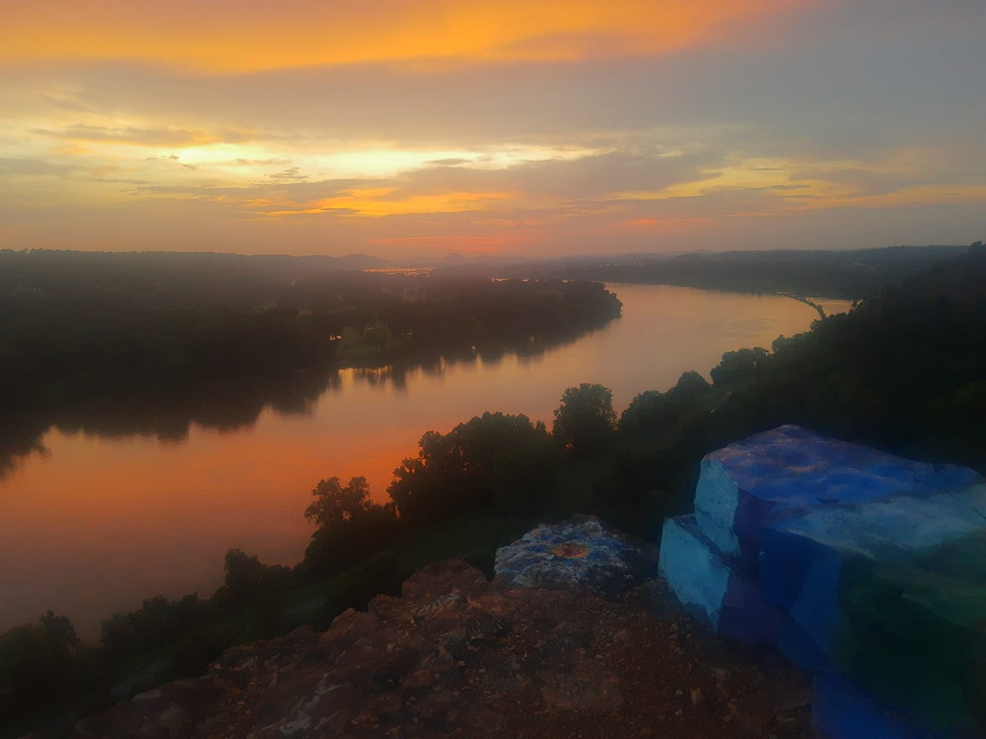
Questions, Thoughts, Feedback

Slide 15

Retirement Mentor Program**
Retirement Seminar Series**
Emeriti Faculty Support**
Onboarding/Orientation**
Leadership, Management, Mentorship Skill Development**
Promotion
Faculty Excellence Seminar Series** Mentoring Program**
Appointment
Sponsorship for Leadership Roles
Chair Professional Development **
Executive Coaching **
Promotion
Center for Faculty Excellence: Faculty Development
Goals:
Promotion Success
Wellness
Retention
KEY
**Professional Fulfillment/ Wellness
= Women’s Faculty Development Caucus
DEI content included
Arts/Humanities content

Slide 16
Center for Faculty Excellence: Faculty Affairs
Appointment
Data Management: Faculty Onboard, Rank changes, and Depart
Adjunct Re-appointment
Promotion
Support P/T Committees
Packet creation and upload training
Faculty Annual Evaluation
Exit Interviews and surveys
Departure or Emeriti transition
Professionalism
Set expectations
Indiv Interventions—IDPs, PIPs, Res Compliance
Policy
Creation/Revision
Dissemination/Interpretation
Departure
Faculty files online
Training and template
Audit
Faculty Mediation Service
Admin Council, AA Council, Aca Affairs Council, FacDev Council,
Recognition
Institutional and College Awards
Collaboration
Asssoc Provosts, Deans, ICFC, Senate, RP, NW
Schwartz Rounds, Team Science, PLE, FacDev Council, Foundation, REOP, etc
Goals:
Retention
Promotion Success
Wellness
Context: Service

Slide 17
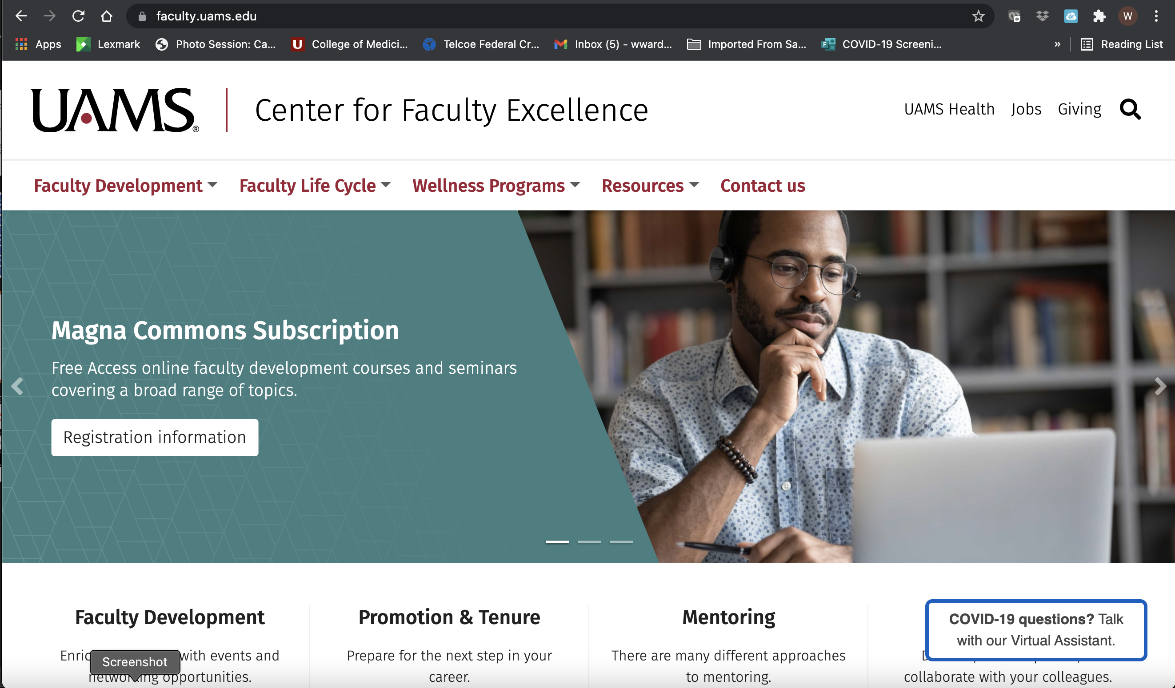
Notes:
FD: FESS total, mentoring program, p/t packet guidance, guidelines
FLC: page for all adjunct to emeriti with links
Wellness program: Faculty Wellness and Interactive Suicide Prevention
Resources:

Slide 18
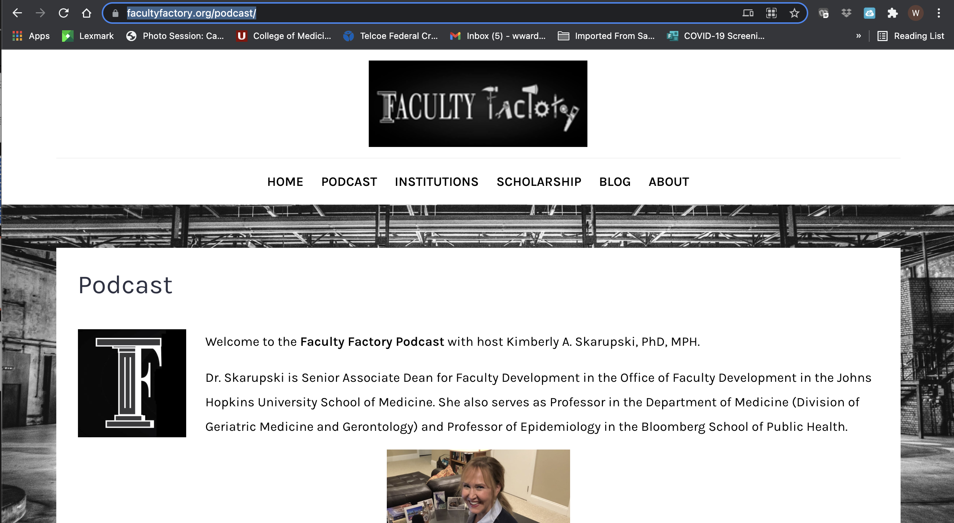
140+ podcasts Apple, Spotify, Youtube, website
Ebook of the best podcasts

Slide 19
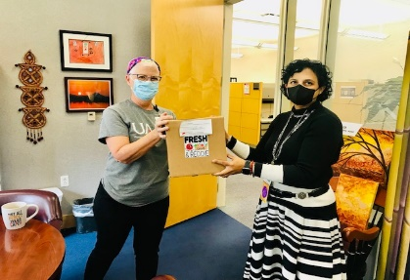
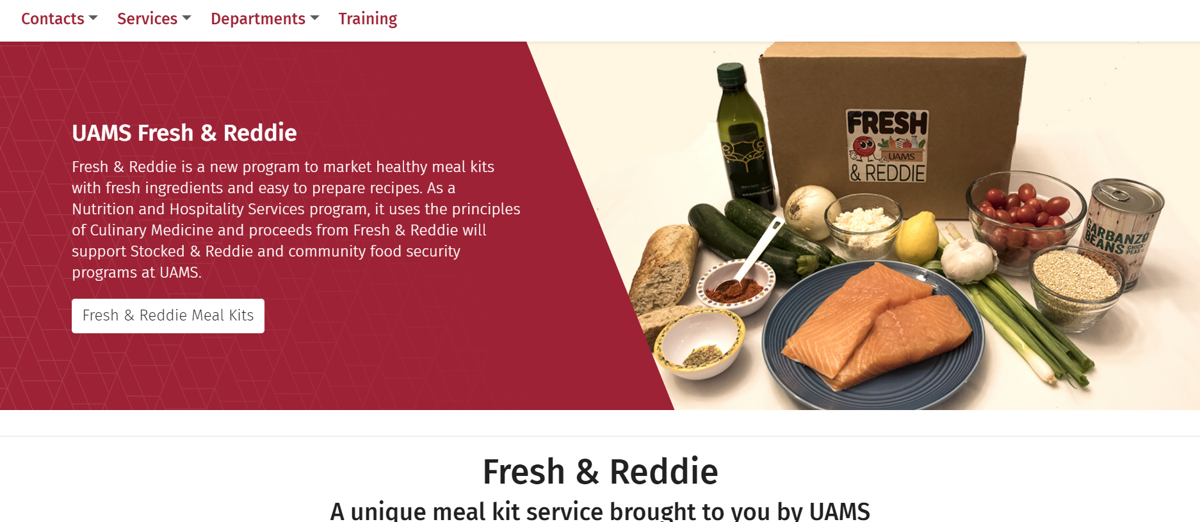

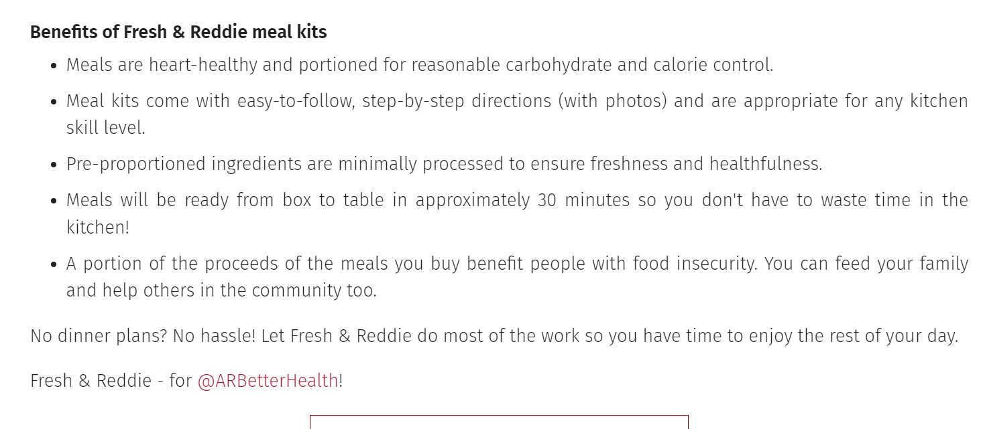
Fresh and Reddie
go.uams.edu/fresh website
https://www.facebook.com/groups/freshandreddie
uams_fresh_and_reddie Instagram page

Slide 20

Pilot kits received today for Fresh and Reddie champions

Slide 21
Announcements and Adjourn
Parliamentarian position open
Election Day: Vote of Full Academic Senate, November 2, 2021
Want to get involved in Academic senate or attend our meetings please email us
pmendiratta@uams.edu
TWHuitt2@uams.edu
BMartin@uams.edu

Slide 22


